Slide 1
Horizon Hotels
AMIN ALHAWARY

Slide 2
ASSUMPTIONS
One hotel per city, although code could be adapted to accommodate more hotels per city.
There is no limit on the number of days booked per reservations.
There is no limit on the number of active reservations per account.

Slide 3
FRONT END AND BACK END
FRONT END:
CSS, HTML and Javascript
BACK END:
Python Flask and mySQL

Slide 4
WEBPAGES
Available for all: Home, Explore, About
Require Login: Booking, Account, Log Out
Require Login AND Admin: Admin
Require Logged Out: Login and Sign Up
Also on webpages, all pages are inherit the same template (HHtemp.html) except home (Hierarchy)

Slide 5
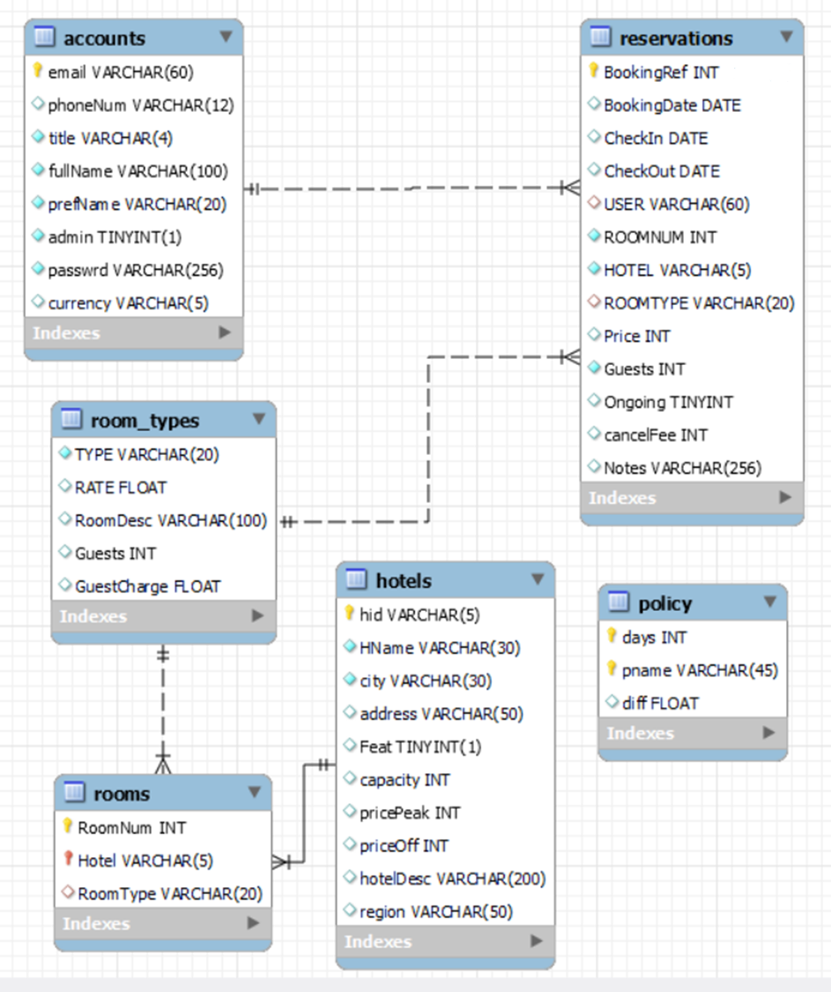
DATABASE ER

Slide 6
HOW DATABASE WAS DESIGNED
Started with 3 tables (reservations, accounts, rooms):
Hotels, off season, peak season and Room Types would be redundant
Then became 4 (reservations, accounts, hotels, rooms):
Now Hotels and Room Types are split, but then in the rooms table containing rooms, room type would be redundant
Afterwards, 5 (reservations, accounts, hotels, rooms, roomTypes)
It is in third normal form because there is no more redundancy
- Added another table “policies”

Slide 7
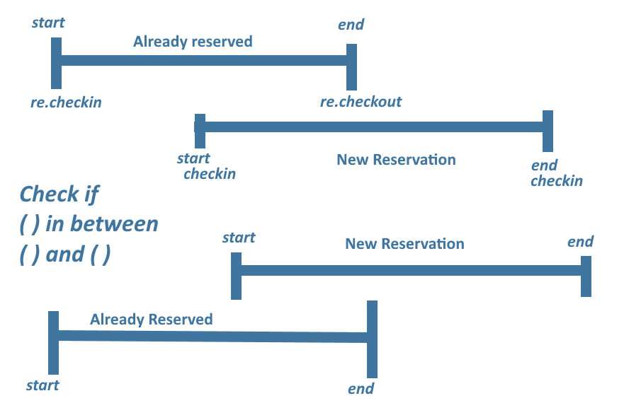
BUSINESS LOGIC
Uses a left join statement when looking for a vacant room.
Guarantees a room which is vacant at those times.
-Checks user’s start date is not between already reserved rooms and vice versa.

Slide 8
LESP
Legal:
Royalty-free images and fonts (No trademark infringement)
GDPR, passwords are hashed
Price ranges are visible without logging in
Ethical:
Environmental (examples: lighthouse throughout development, going for mobile first)
- Made sure user data is secure
Social:
Webpage is responsive and accessible
No flashing text and clear design
Professional:
Style is consistent throughout website
Testing

Slide 9
SECURITY
Prevented SQL injection attacks by converting all variables to string before usage in SQL
Where applicable, select has replaced text inputs to reduce errors and vulnerability, text inputs have validation as well
Passwords are hashed, each user has unique salt
No variable values are taken through URL to prevent cross side scripting

Slide 10
TESTING
Test Two: Database Updates
Test One: Validation on different forms

Slide 11
Test Three: Number of rooms change
Test Four:

Slide 13
EXTRA USER FEATURES
Normal User:
Change user details
Cancel bookings
Delete account
Admin:
Change user password
Cancel bookings

Slide 14
EVALUATION
Most specifications covered
Could be more efficient
Could apply improved room-assignment to reduce losses

